Slide 1
Final Project
Adam Calabrese, Walter Contreras, Spencer Kehoe

Slide 2
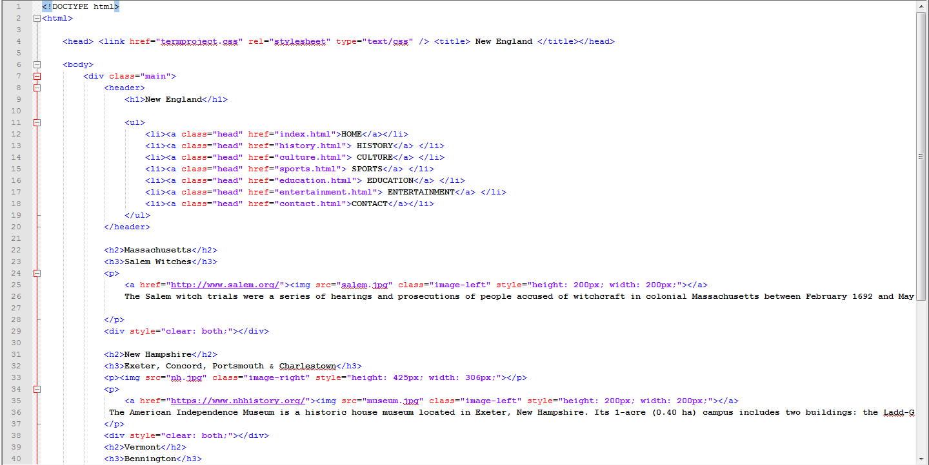
HTML Code (General Layout)

Slide 3
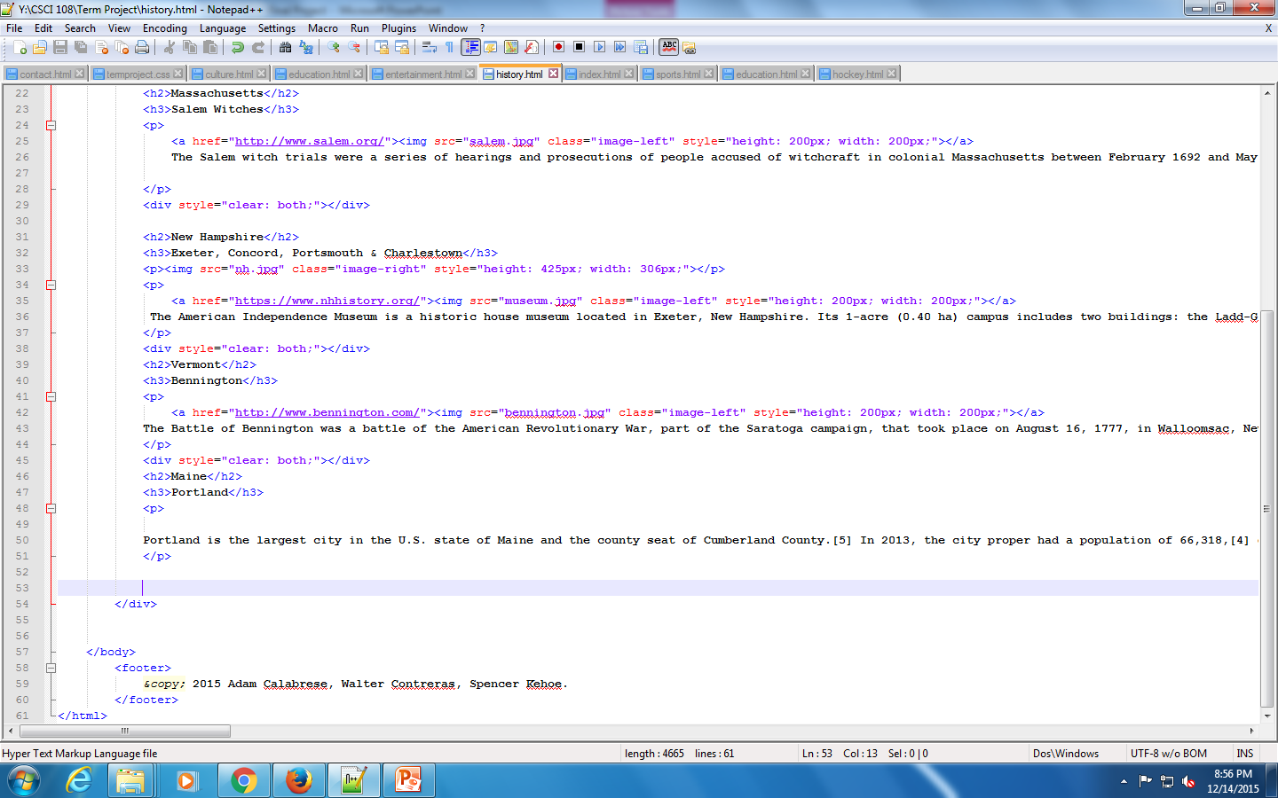
HTML Code (General Layout)

Slide 4
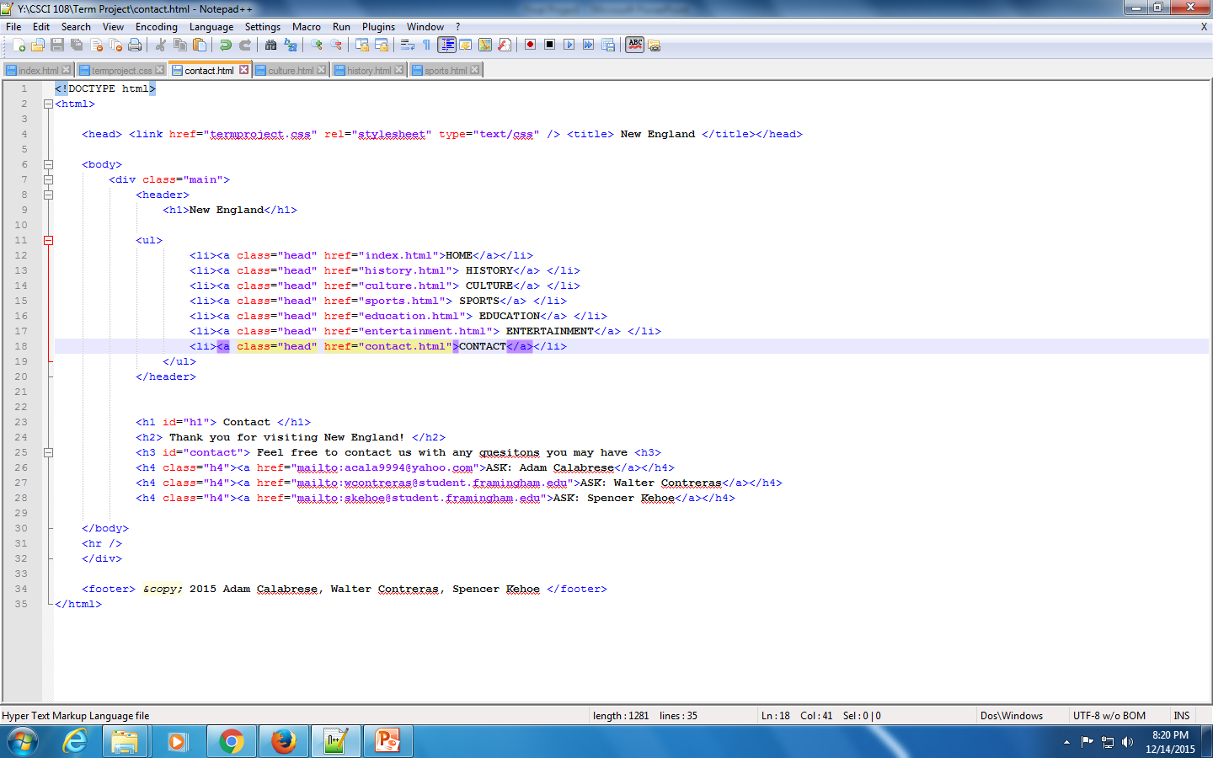
HTML Code (Contact/Mail To)

Slide 5
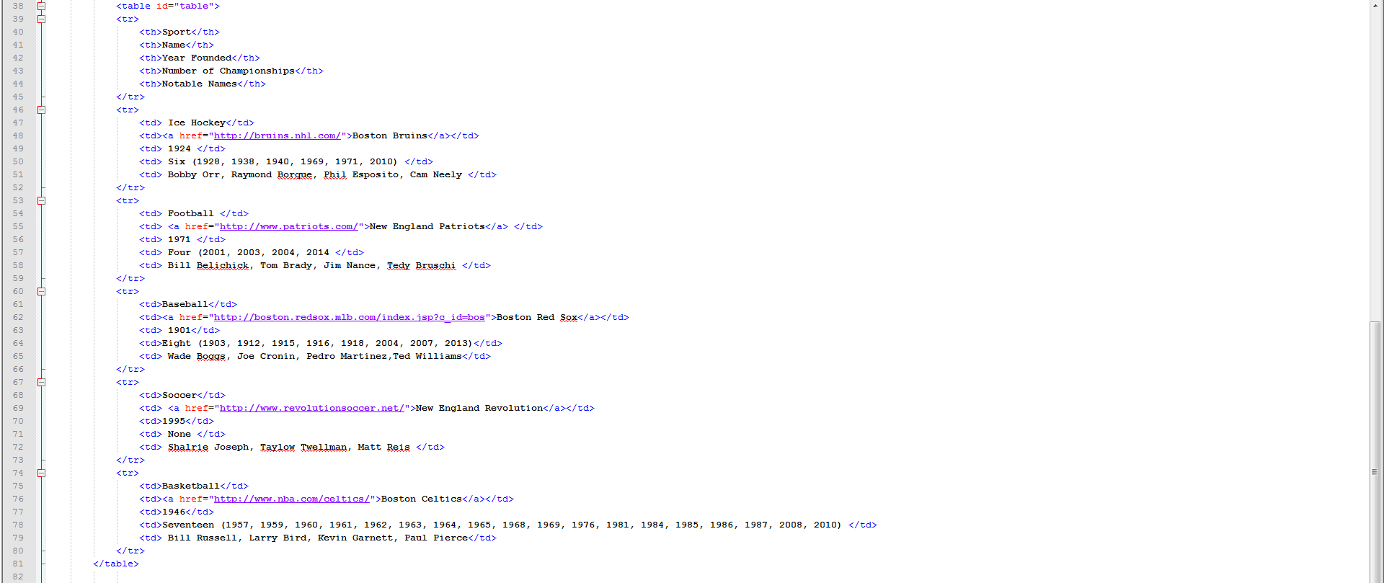
HTML Code (Table)

Slide 6
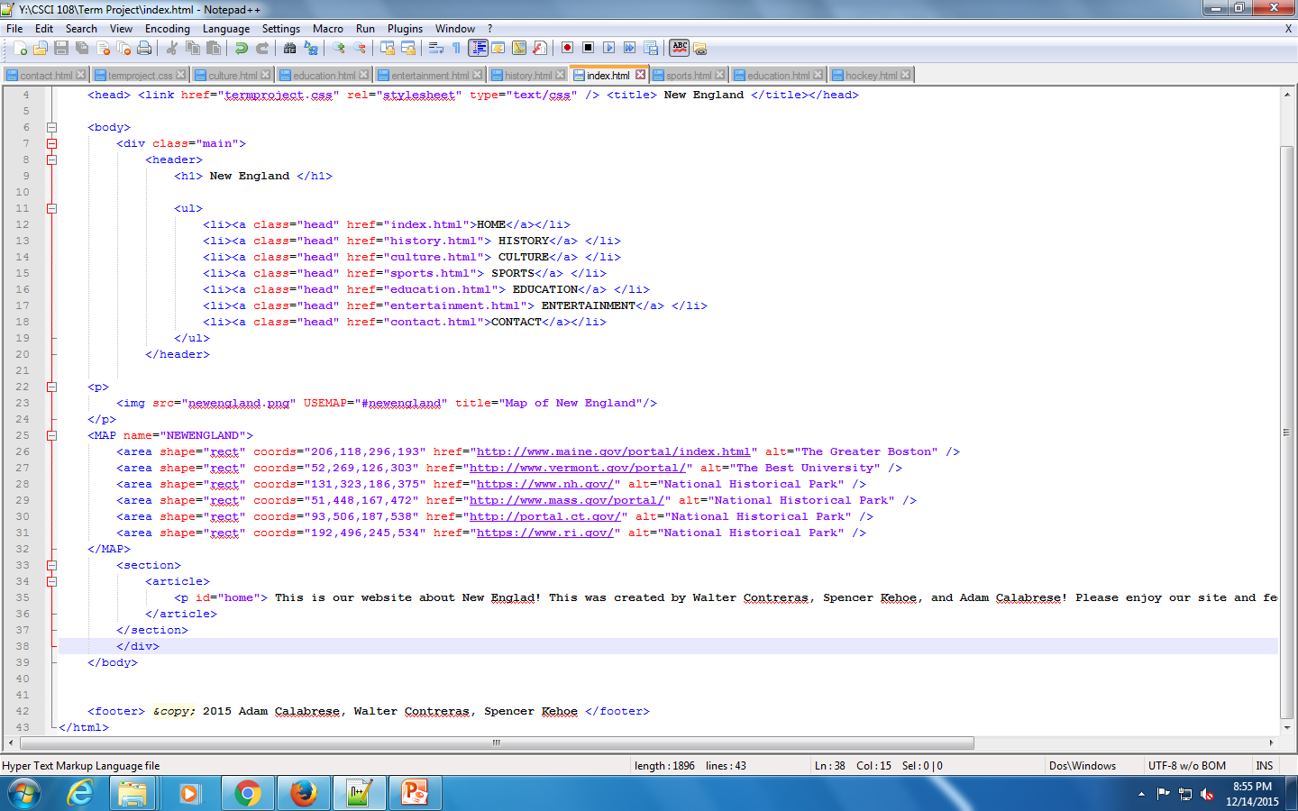
HTML Code (Image Map)

Slide 7
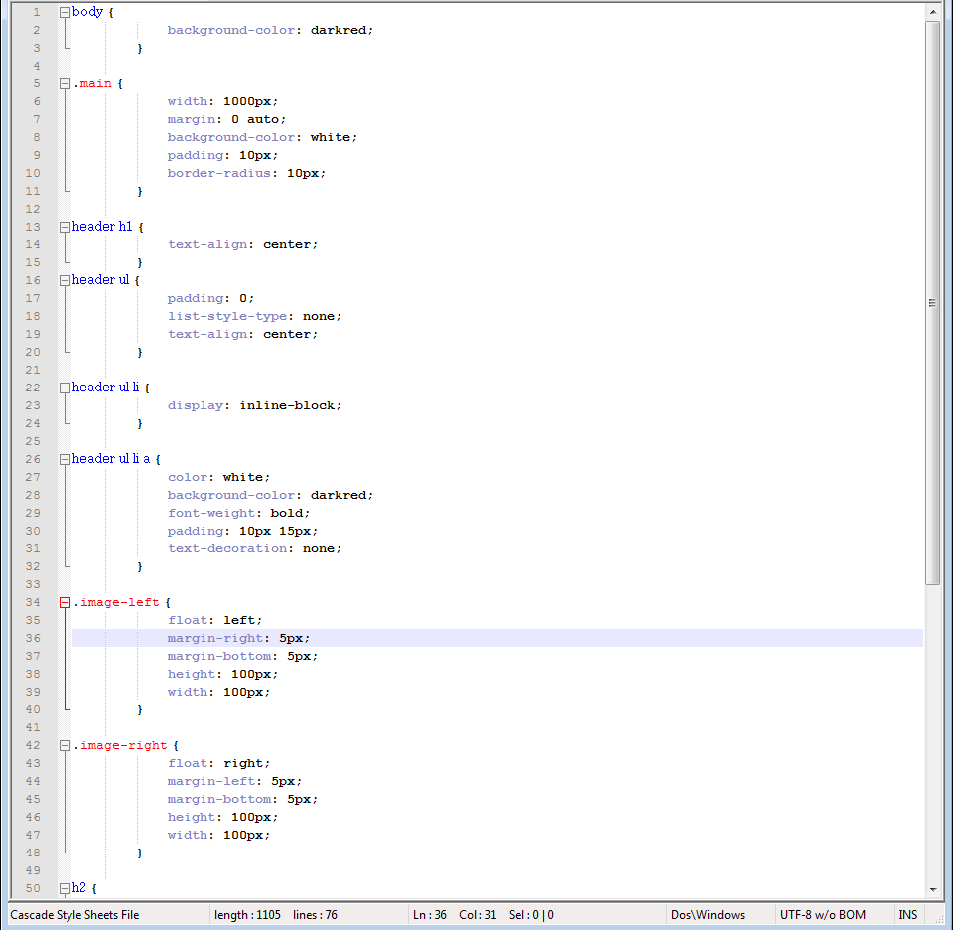
CSS Explained

Slide 8
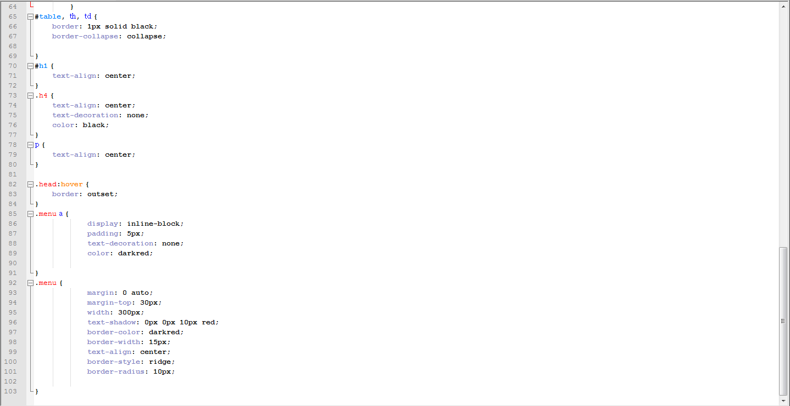
CSS Explained cont.

